Slide 1
Personalized Medicine and Cancer Treatment
Yepeng Li

Slide 2
Background
Precision medicine is hot topic recent days.
Genetic testing for gene variations.
Cancer treatment will be disrupted by genetic testing.

Slide 3
Data set
Variables
Gene
Variation
Text
Predict
Mutation class 1-9
Personalized medicine and Cancer treatment(Kaggle competition)

Slide 4
Explanatory Data Analysis
Gene:
Gene frequency in mutation classes
Top genes distribution in different classes
Top 10 occurred genes

Slide 5
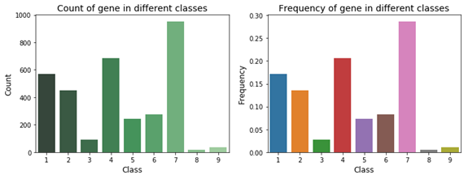
Explanatory Data Analysis
Fig1. Gene frequency in nine mutation classes
Gene’s frequency peaks at class 7, lowest gene occurrence class are 8 and 9.

Slide 6
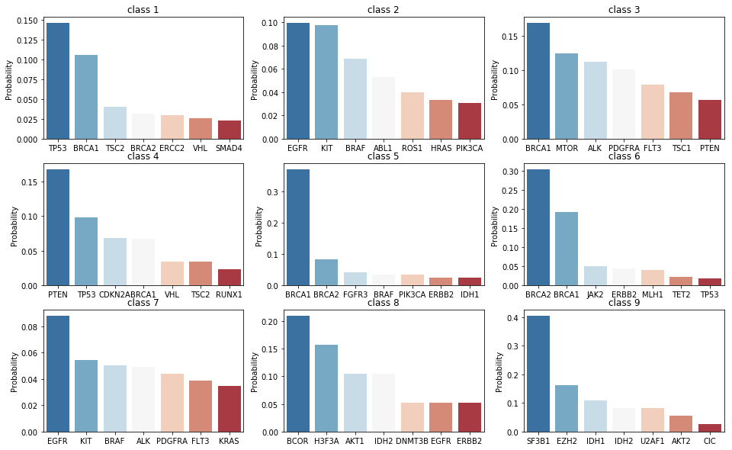
Explanatory Data Analysis
Fig2. Top seven genes distribution in different classes
EGFR ranks first in top 10 occurred genes and it mainly distributed in class 2 & 7.

Slide 7
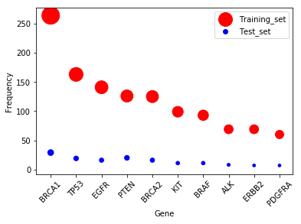
Explanatory Data Analysis
Fig3. Top 10 occurred genes
The top 10 genes in training are lower expressed in test set.

Slide 8
Explanatory Data Analysis
Variations:
Top 10 Variations
Top variations in different classes

Slide 9
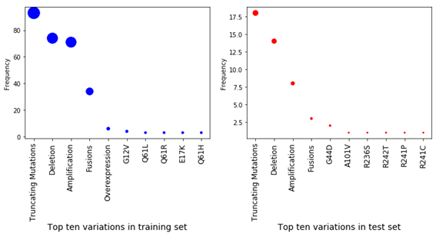
Explanatory data analysis
Fig4. Top 10 variations
There are 4 common top 10 variations in training and test set.

Slide 10
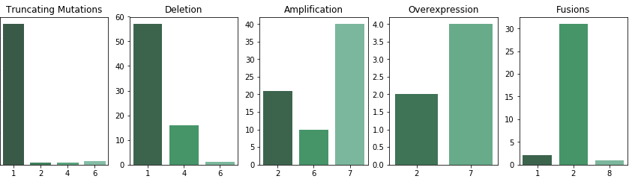
Explanatory Data Analysis
Fig5. Top 5 variations' class distribution
Top three and top four variations are Amplification and Fusions.
They are mainly located in Class 2 and 7.

Slide 11
Explanatory Data Analysis
Text:
Text length overview in training set and test set
Text distribution by class in training set
Top 10 TF-IDF features in class 2 and 7

Slide 12
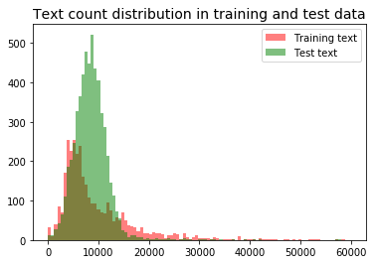
Explanatory Data Analysis
Fig6. Text length overview
The most frequent text count in training set is about 5000 while that in test set is about 10000.

Slide 13
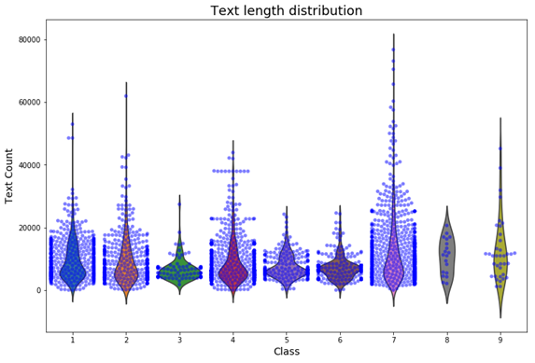
Explanatory Data Analysis
Fig7. Text length distribution by class
Text count in Class 7 ranges from 1 to nearly 80000.
Class 8 and 9 have the smallest ranges.

Slide 14
Explanatory Data Analysis
TF-IDF is an information retrieval technique.
The TF of a word is the frequency of a word in a document.
The IDF of a word is the log value of total number of documents in the corpus divided by the number of documents containing the word.
The higher the TF*IDF score (weight), the rarer the term.

Slide 15
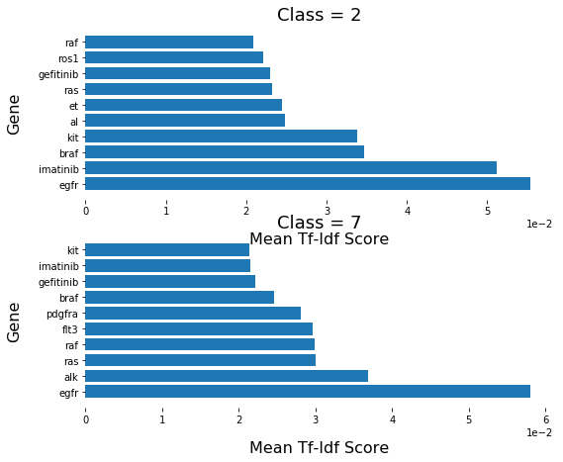
Explanatory data analysis
There are seven common text features in the two classes. There are 70% similarity for the top 10 text features between class 2 and class 7!

Slide 16
Base model building without text processing
Using variable 'Gene' and 'Variation' as predictors.
Base model’s test accuracy is 0.93.
Highest text model (the following part) accuracy is 0.63.
Text variable has large variation while the gene and variation distribution are very similar in training and validate set.

Slide 17
Text Processing and Model Building
Fig8. Count vector and TF-IDF
TF-IDF has better performance than Count vector.
The model accuracy of test set is from 0.60 to 0.63. TF-IDF/GBM model performs best.

Slide 18
Text model with new stop words
Scientific terminology and stop words: “fig”, “figure”, “et”, “al”
Research field related stop words: “abstract”, “background”
Paper notation quirks: [11, 12]

Slide 19
Text model with new stop words
Fig9. Comparison of text models with new stop words/ stop words ‘English’
New stop words have dramatically decreased the log loss value in Naïve Bays model.
The model accuracy of new stop words is a little bit lower than that of stop words ‘English’.

Slide 20
Truncated SVD
Truncted SVD performs linear dimensionality reduction by means of truncated singular value decomposition (SVD).
The model accuracy of Truncted SVD is lower than that of pure TF-IDF model.

Slide 21
Word2vec
 | log loss | test accuracy
Logistic regression | 1.37 | 0.51
Random Forest | 1.37 | 0.52
Word2vec is a group of related models that are used to produce word embedding.
These models are shallow, two-layer neural networks that are trained to reconstruct linguistic contexts of words.

Slide 22
LSTM
Keras is a high-level neural networks API.
Written in Python and capable of running on top of Tensor Flow, CNTK, or Theano.
Developed with a focus on enabling fast experimentation.

Slide 23
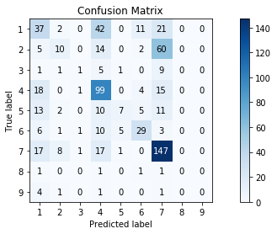
LSTM
Keras Model:
Log loss: 1.37
Accuracy: 0.50
The dirty LSTM model's accuracy in test data set is 0.50.
There are 60 class 2 being predicted as class 7 and occupy 50% of false positive of class 7(60/121).

Slide 24
Comparison of five methods
The TF-IDF models with stop words ‘English’ / new stop words have close log loss and test accuracy.
The test accuracies of Truncted SVD, Word2vec and Keras model are lower than that of TF-IDF model. But they are still promising!

Slide 25
Future job
Trying to find better way to get word vector.
Normalizing text data. For example, deleting the duplicate parts, citing only the abstract part of the paper.

Slide 26
Future job
Trying to find better way to get word vector.
Normalizing text data. For example, deleting the duplicate parts, citing only the abstract part of the paper.

